Slide 1
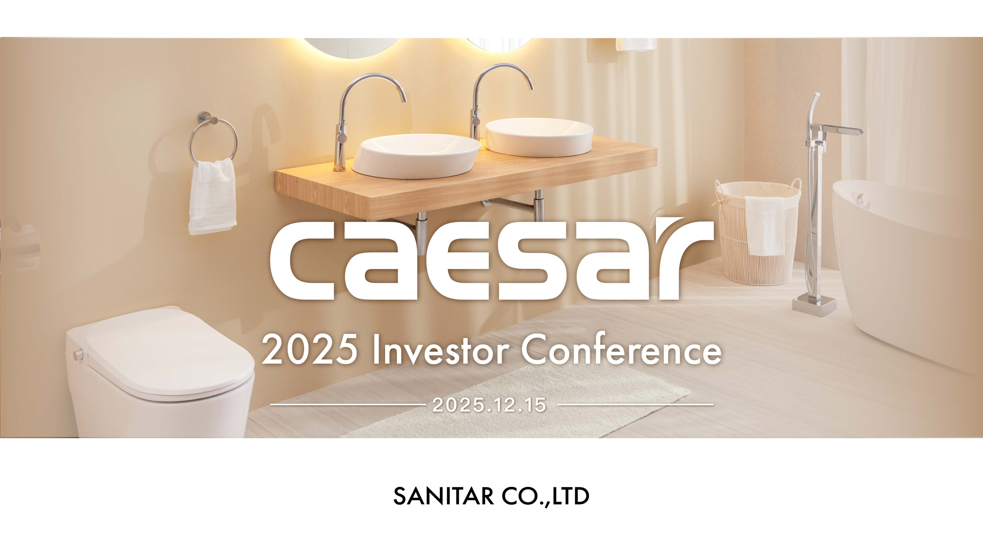

Slide 2

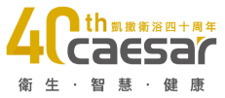
Legal Disclaimer
The information is provided for informational purposes only, and is not an offer to buy or sell or a solicitation of an offer to buy or sell any security issued by Sanitar or other parties.
Sanitar’s statements that are only historical and there are not any financial prediction.
Sanitar does not warranty their accuracy, reliability and completeness. There are a number of factors such as economic conditions, firms abilities, industry environment that could cause actual results and developments. Investors should not place undue reliance on them.
2

Slide 3
Contents
01
Company Profile
02
Operational Overview
03
Outlook
3

Slide 4
01
Company Profile
4

Slide 5
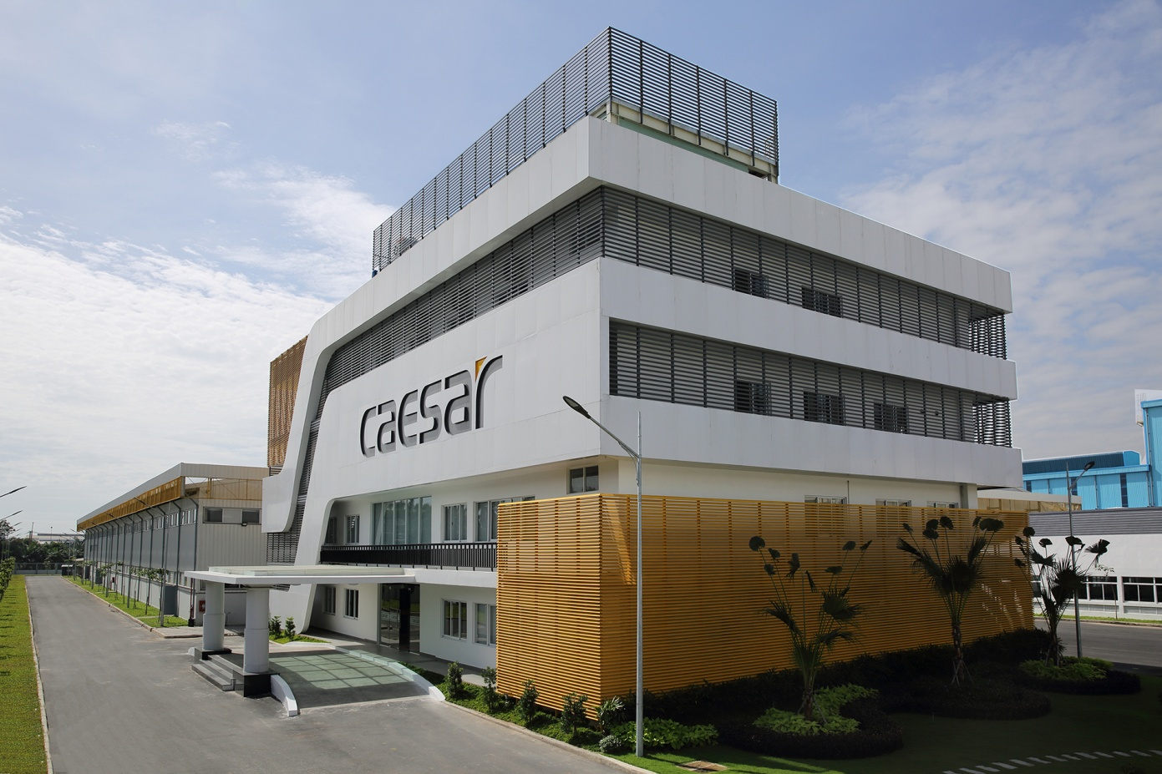
Company Information
Headquarters
Founded
IPO
ISO
Number of Employees
Caesar Sanitary Ware Taiwan
Dec 10, 1985
Oct 24, 2013 (TWSE : 1817)
195 (TW) 1074(VN)
ISO9001
Caesar is Asia’s most stylish sanitary ware brand. Founded in 1985, the company expanded to Vietnam in 1996 with its first overseas manufacturing facility. Today, Caesar operates four major factories producing ceramic ware, faucets, bathtubs, and cabinets.
With a global supply chain and sales network, Caesar was listed on the Taiwan Stock Exchange in 2013 (Stock Code: 1817), and is recognized as one of Taiwan’s premium publicly listed companies—offering customers complete peace of mind when choosing Caesar products.
Caesar continues to deliver products that combine contemporary style with practical functionality, bringing greater convenience and happiness to everyday life.
5

Slide 6

40th Brand Milestones
項目
年度
年度
項目
6
Notes:
Other countries, including Japan, Korea, Malaysia, China, Philippines, Australia, Myanmar, Cambodia, USA, etc

Slide 7
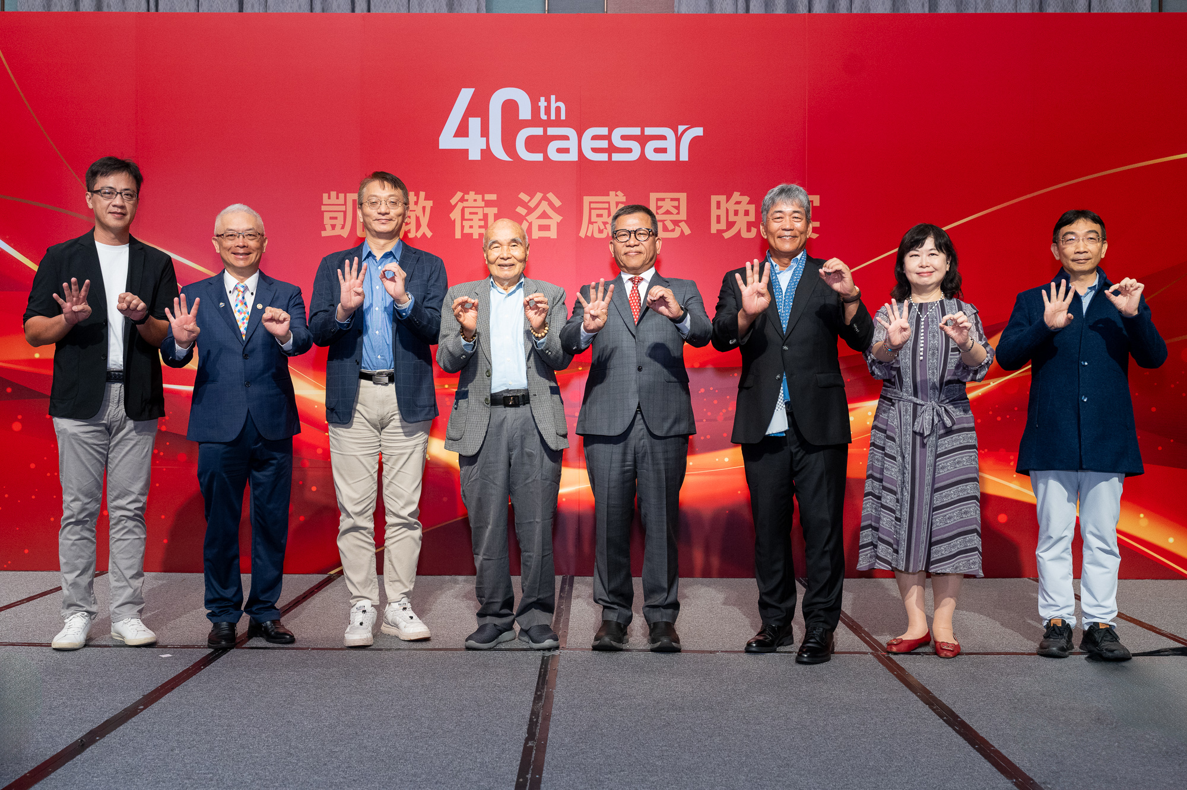
40th品牌歷程
項目
年度
年度
項目
7
Notes:
Other countries, including Japan, Korea, Malaysia, China, Philippines, Australia, Myanmar, Cambodia, USA, etc

Slide 8
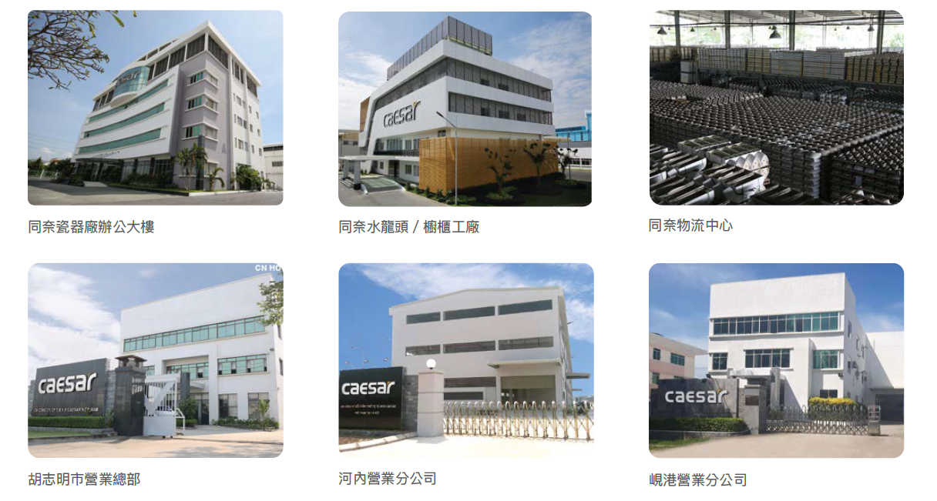
Caesar in Vietnam
項目
年度
年度
項目
8
Notes:
Other countries, including Japan, Korea, Malaysia, China, Philippines, Australia, Myanmar, Cambodia, USA, etc

Slide 9

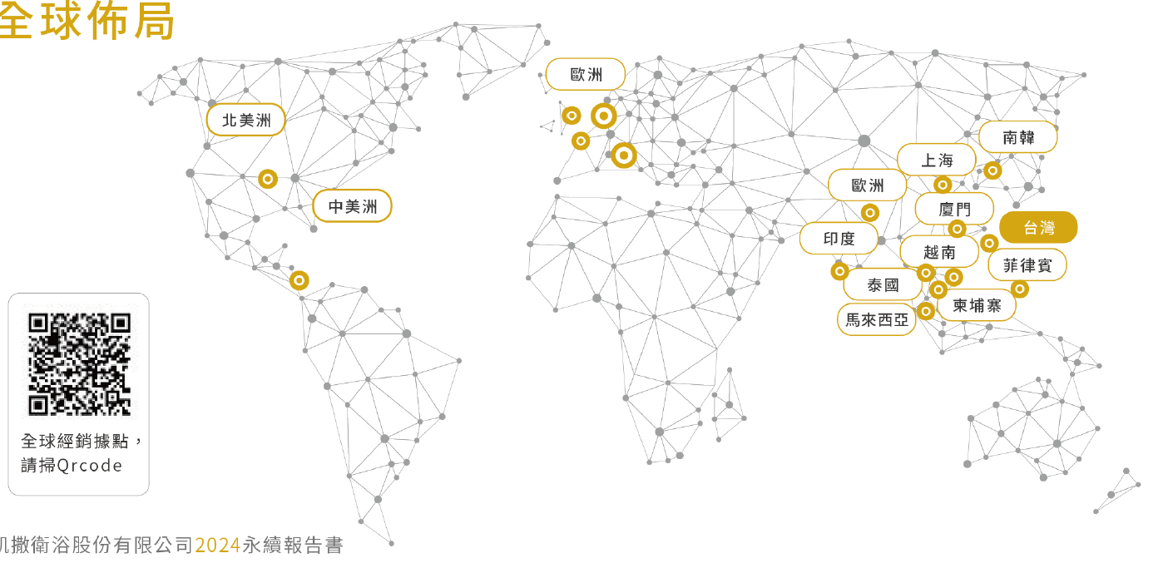
Caesar Global Supply Chain and Sales Network
項目
年度
年度
項目
9
Notes:
Other countries, including Japan, Korea, Malaysia, China, Philippines, Australia, Myanmar, Cambodia, USA, etc

Slide 10
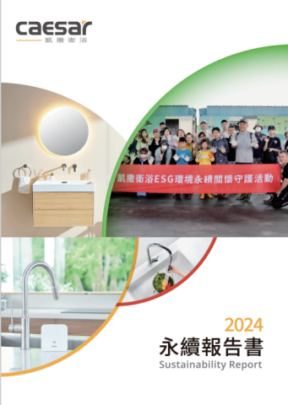
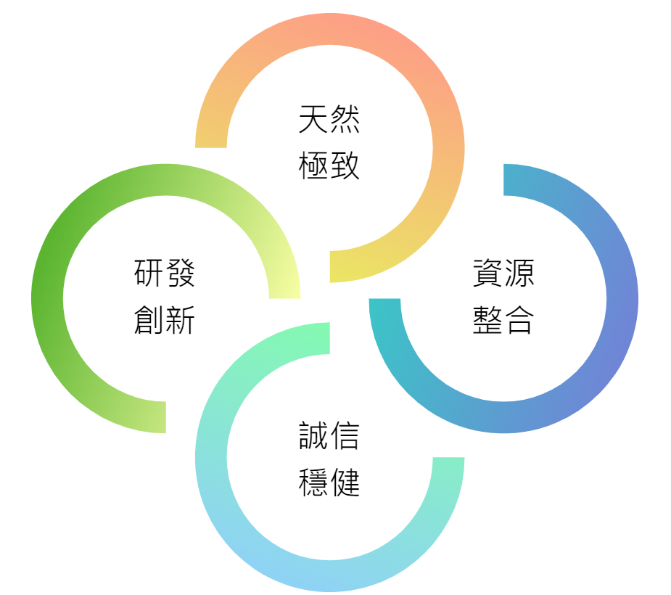
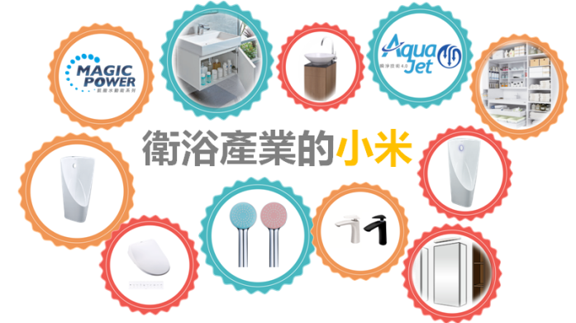
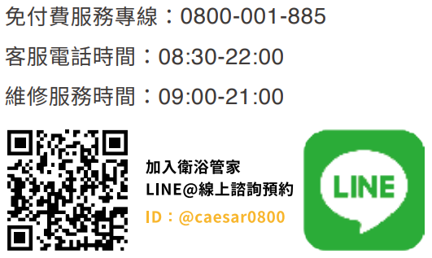
Business Concept
項目
年度
誠信
務實
Ethics
年度
項目
品質至上
Quality
環境關懷
ECO
Green, Tech, Eco, Health
“Mi” in sanitary ware
Stylish Elegance brand positioning
客戶滿意
Customer
Caesar professional technician
10
Notes:
Other countries, including Japan, Korea, Malaysia, China, Philippines, Australia, Myanmar, Cambodia, USA, etc

Slide 11
Value Creation
Dividend Payout Ratio | 62.99% | 71.71% | 62.89% | 64.71% | 64.25% | 65.71% | 68.95% | 65.79% | 65.15% | 56.93% | 55.05% | 54.92%
ROE | 14.23% | 13.40% | 15.86% | 16.09% | 16.46% | 15.32% | 10.69% | 13.17% | 12.62% | 15.49% | 11.78% | 14.92%
11
Notes:
以價值型企業為目標，創造消費者與股東權益最佳化

Slide 12
02
Operational Overview
12

Slide 13

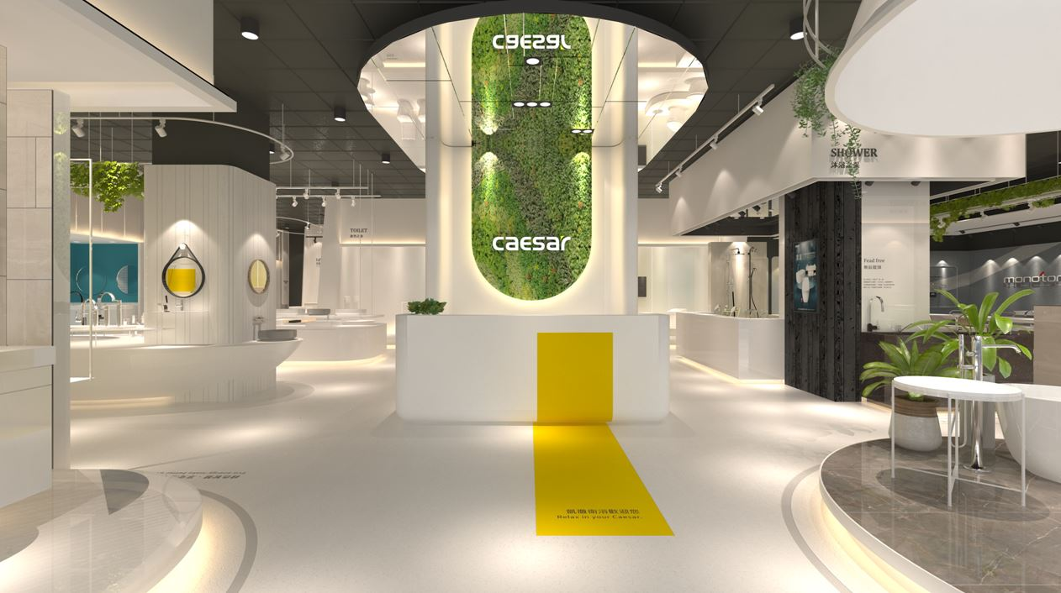
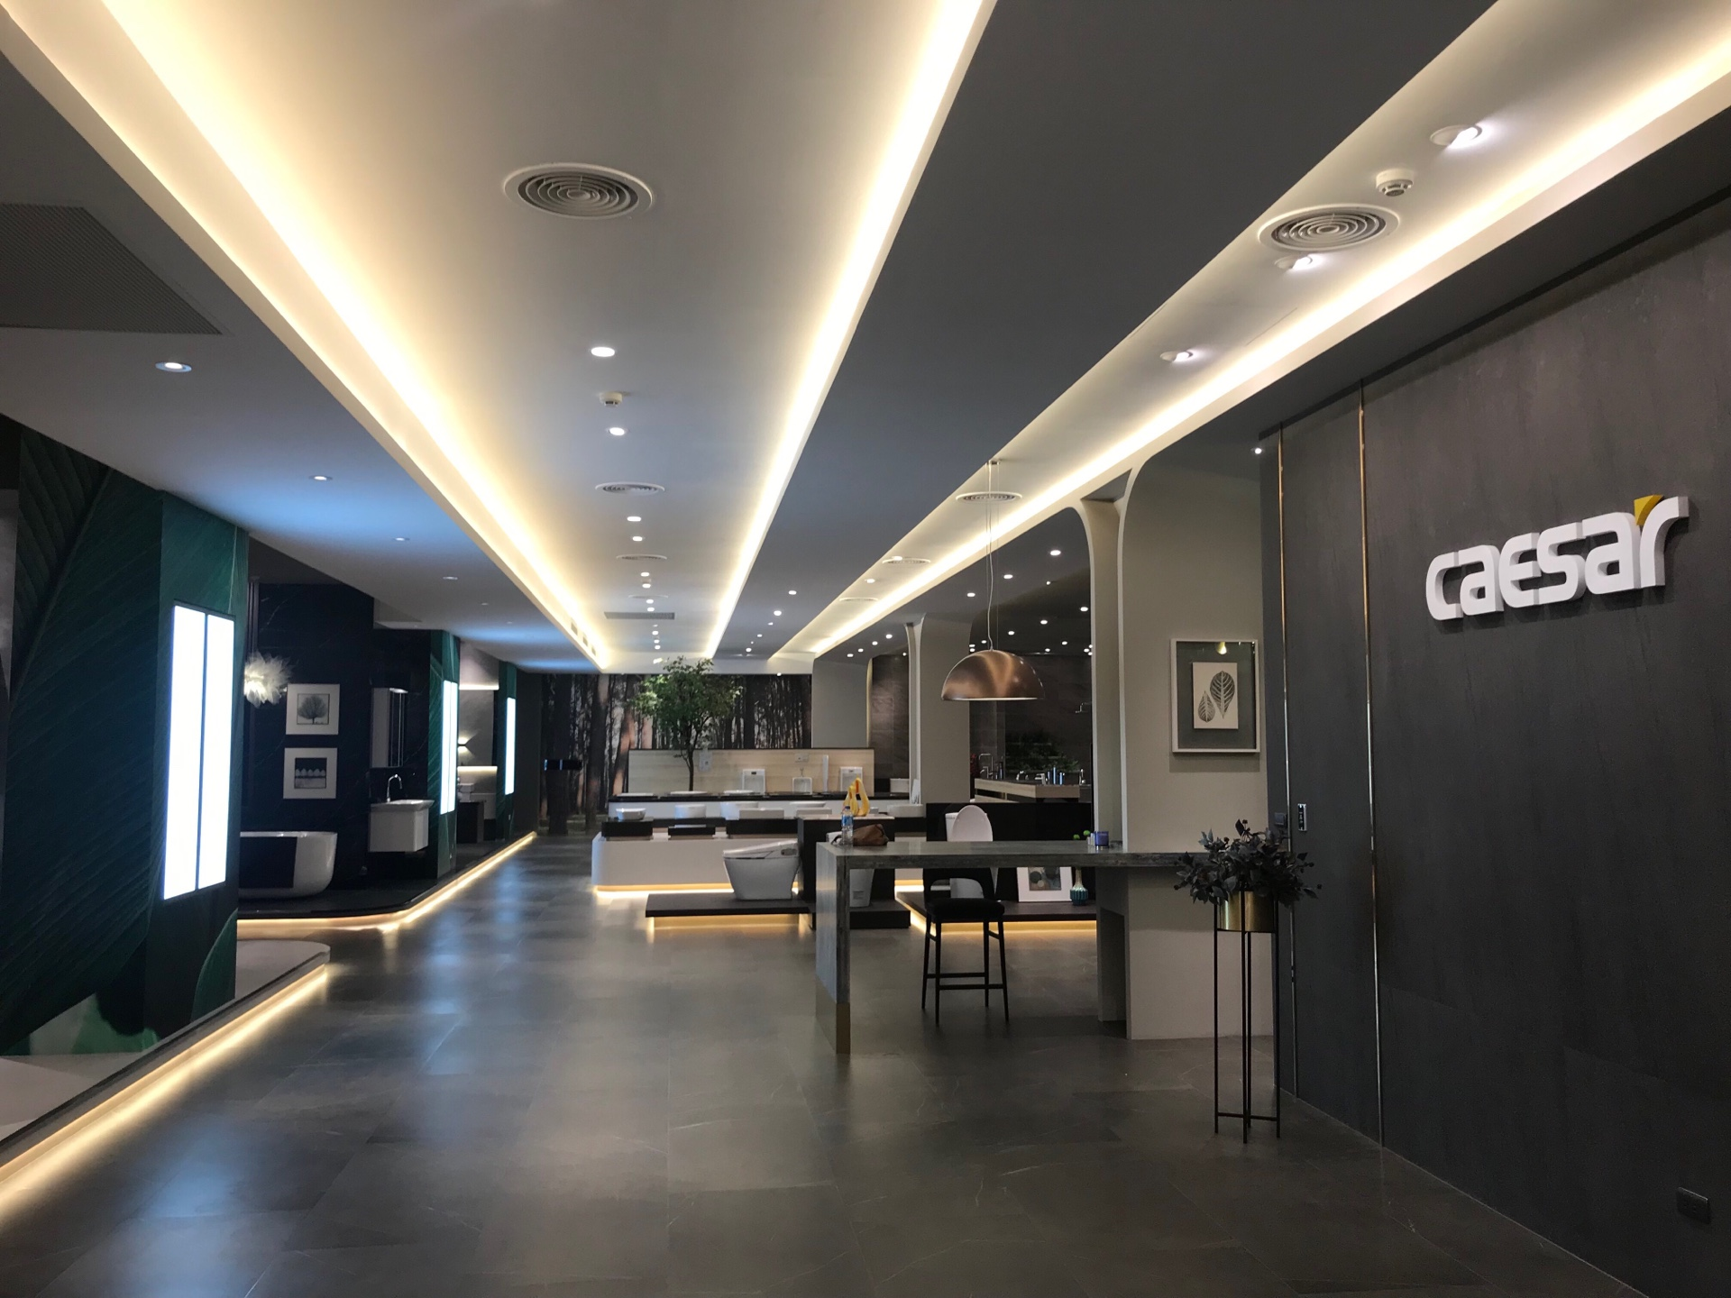
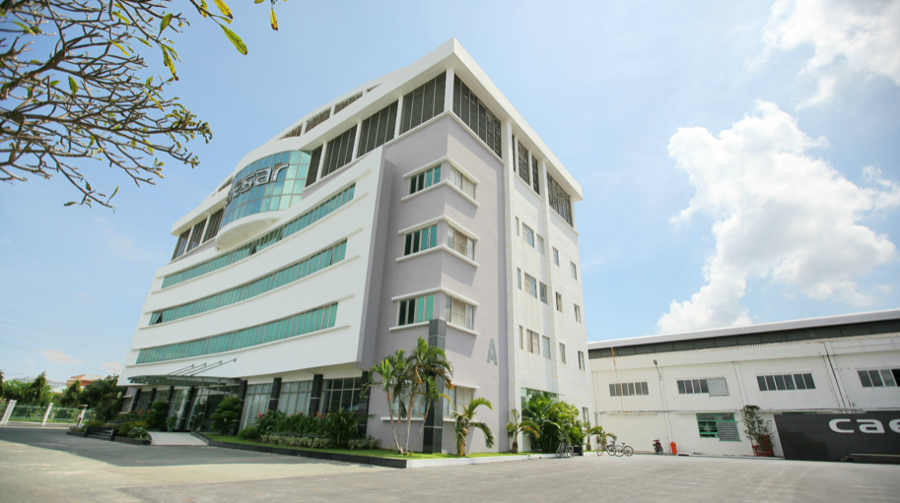
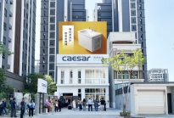
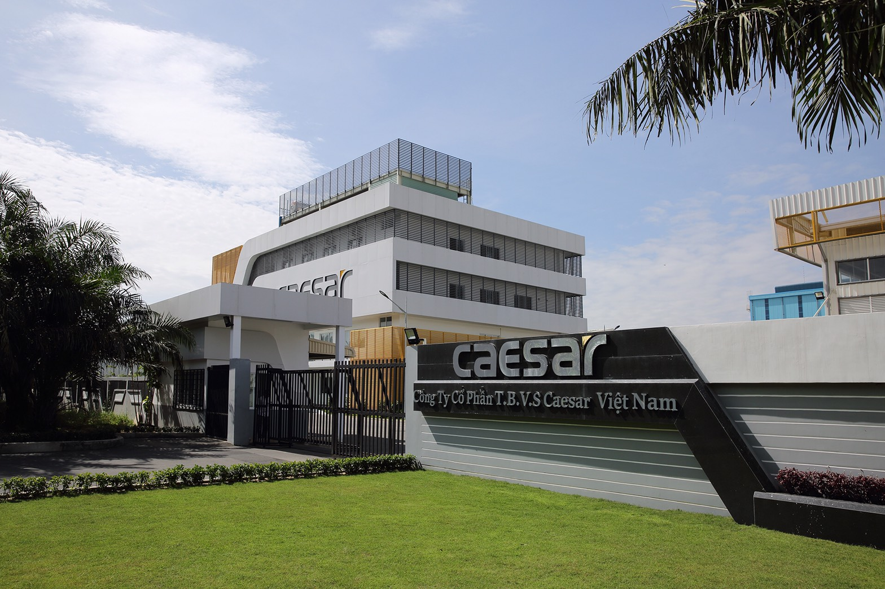
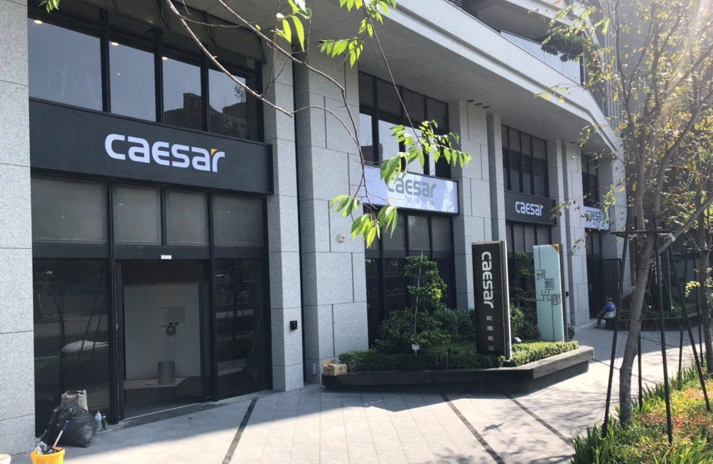
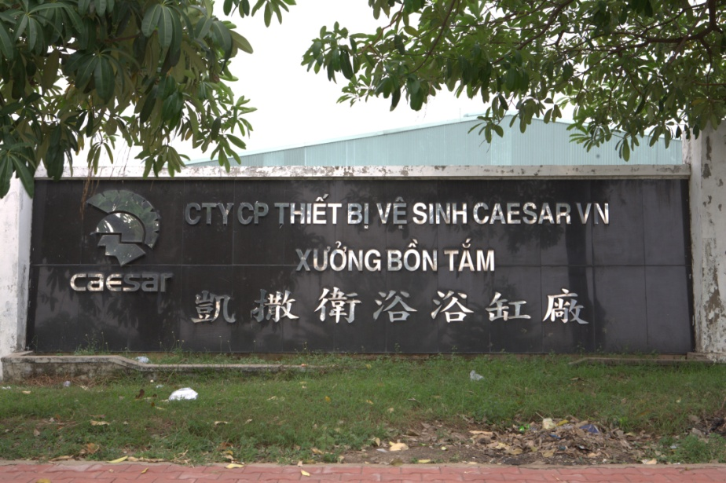
Our Global Presence
Vietnam
Taiwan
Revenue by Region
Revenue by Region
FYE2025 Q1~Q3
FYE2025 Q1~Q3
27%
73%
40 years
1,000+
NTD 1.94 billion
Brand Legacy
Employees
Revenue of 2025 Q1~Q3
13
Notes:
Other countries, including Japan, Korea, Malaysia, China, Philippines, Australia, Myanmar, Cambodia, USA, etc

Slide 14
Financial Results
(UNITS: In Thousands of New Taiwan Dollars)
 | Consolidated comprehensive income statements of past years
 | FY2025 Q1~Q3 | FY2024 | FY2023 | FY2022 | FY2021 | FY2020 | FY2019
Operating Revenue | 1,946,149 | 2,790,325 | 2,500,832 | 2,669,606 | 2,372,638 | 2,306,521 | 2,334,926
Debt to Total Assets | 25.46% | 19.68% | 24.26% | 25.79% | 33.95% | 32.69% | 33.02%
Current Ratio | 372.97% | 580.47% | 383.60% | 344.67% | 239.89% | 195.51% | 180.86%
Quick Ratio | 214.73% | 297.94% | 194.61% | 153.85% | 108.36% | 80.12% | 92.09%
Return on Equity | 9.14% | 14.92% | 11.66% | 15.43% | 12.78% | 12.91% | 10.60%
Profit Before Tax to Capital Stock | 36.77% | 56.27% | 42.45% | 52.81% | 39.63% | 39.88% | 33.82%
Earnings Per Share | 2.75 | 4.37 | 3.27 | 4.04 | 3.07 | 3.04 | 2.48
Average stock price | 43.42 | 39.72 | 37.58 | 37.74 | 36.03 | 33.44 | 35.15
P/E Ratio | 11.84 | 9.09 | 11.27 | 9.34 | 11.74 | 11.00 | 14.17
年度
項目
14
Notes:
Other countries, including Japan, Korea, Malaysia, China, Philippines, Australia, Myanmar, Cambodia, USA, etc

Slide 15
Financial Results
(UNITS: In Thousands of New Taiwan Dollars)
 |  | FY2025 Q3 | % | FY2024 Q3 | %
Financial Results | Operation Revenue | 657,945 | 100 | 714,691 | 100
 | Operation Cost | 417,792 | 64 | 463,829 | 65
 | Gross Profit | 240,153 | 37 | 250,862 | 35
 | Operation Expenses | 148,801 | 23 | 157,757 | 22
 | Profit From Operation | 91,352 | 14 | 93,105 | 13
 | Income Before Income Tax | 113,002 | 17 | 92,361 | 13
Profitability Ratio | Return on Assets | 3.11% |  | 2.70%
 | Return on Equity | 4.17% |  | 3.45%
 | Operating Income to Capital Stock | 12.58% |  | 12.82%
 | Profit Before Tax to Capital Stock | 15.57% |  | 12.72%
 | Profit Margin | 13.50% |  | 10.31%
 | Earnings Per Share | 1.21 |  | 1.01
項目
年度
15
Notes:
Other countries, including Japan, Korea, Malaysia, China, Philippines, Australia, Myanmar, Cambodia, USA, etc

Slide 16
Financial Results
(UNITS: In Thousands of New Taiwan Dollars)
 |  | FY2025 Q1~Q3 | % | FY2024 Q1~Q3 | %
Financial Results | Operation Revenue | 1,946,149 | 100 | 2,012,906 | 100
 | Operation Cost | 1,243,840 | 64 | 1,305,861 | 65
 | Gross Profit | 702,309 | 36 | 707,045 | 35
 | Operation Expenses | 461,046 | 24 | 451,309 | 22
 | Profit From Operation | 241,263 | 12 | 255,736 | 13
 | Income Before Income Tax | 266,945 | 14 | 281,649 | 14
Profitability Ratio | Return on Assets | 7.02% |  | 8.14%
 | Return on Equity | 9.14% |  | 10.50%
 | Operating Income to Capital Stock | 33.23% |  | 35.22%
 | Profit Before Tax to Capital Stock | 36.77% |  | 38.79%
 | Profit Margin | 10.30% |  | 11.04%
 | Earnings Per Share | 2.75 |  | 3.06
項目
年度
16
Notes:
Other countries, including Japan, Korea, Malaysia, China, Philippines, Australia, Myanmar, Cambodia, USA, etc

Slide 17
Financial Results
2025 Q1~Q3
Operation Revenue YoY -3.32%
EPS YoY -10.13%
項目
年度
年度
項目
17
Notes:
Other countries, including Japan, Korea, Malaysia, China, Philippines, Australia, Myanmar, Cambodia, USA, etc

Slide 18
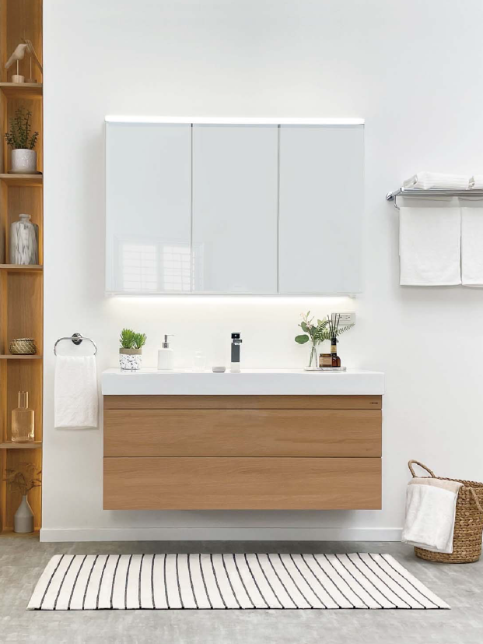
Caesar in Taiwan
2025 Q1~Q3 YoY
-8.05%
Sales by Segment
Residential Remodeling 69%
New Housing 31%
18

Slide 19
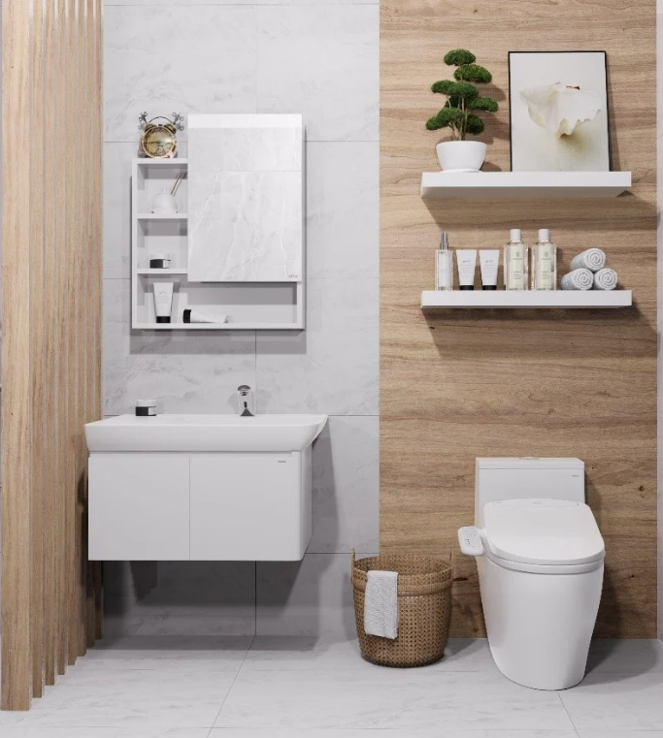
Caesar in Vietnam
2025 Q1~Q3 YoY
21.30%
Sales by Segment
Residential Remodeling 73%
New Housing 27%
19

Slide 20
03
Outlook
20

Slide 21
Business Prospection
Market
New
Existing
Housing Market
Kitchen Cabinet in Vietnam
年度
Brand Value Creation
年度
Vision
Top 10 Brand in sanitary
ware in Asia
Mission
Create high-quality life
with bathroom solutions
項目
OEM
ODM
Plasma
Faucet
Sanitary Ware
Faucet Fixtures
K&B Cabinet
Electronic
Others
UB
Existing New Product
21
Notes:
Other countries, including Japan, Korea, Malaysia, China, Philippines, Australia, Myanmar, Cambodia, USA, etc

Slide 22
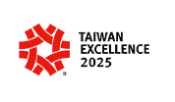

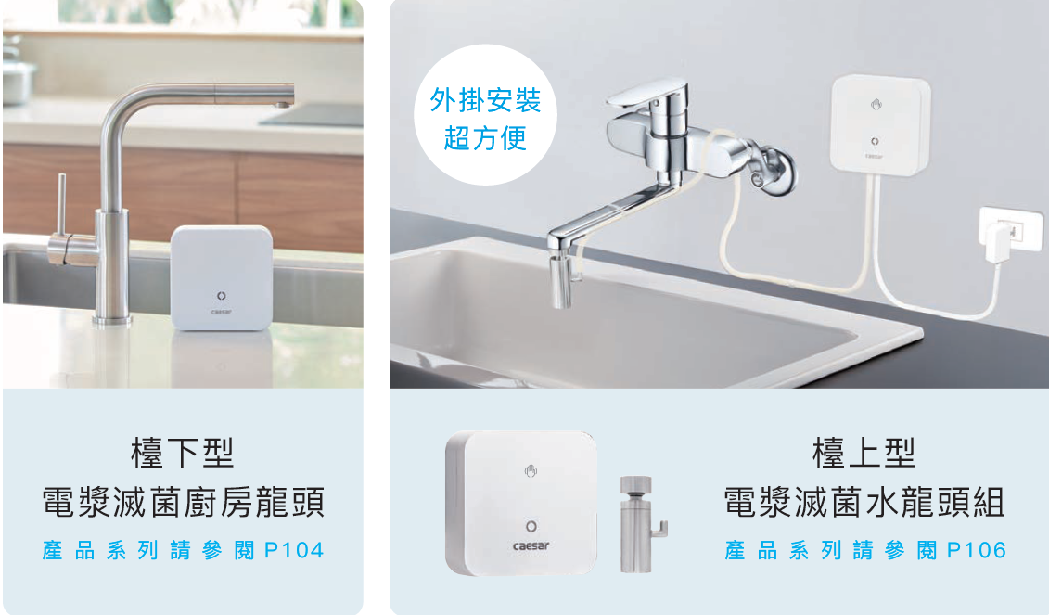
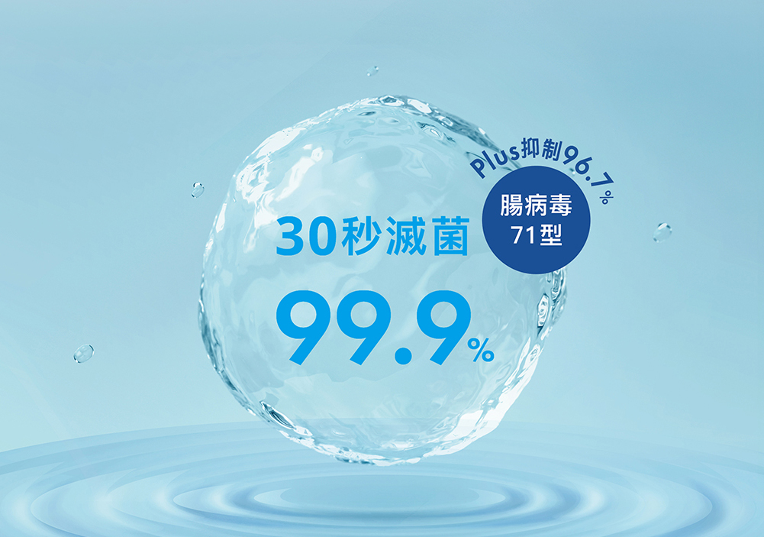
Plasma Kitchen Faucet wined International Award
Inhibits Enterovirus 71 by 96.7% within 60 seconds.
22

Slide 23
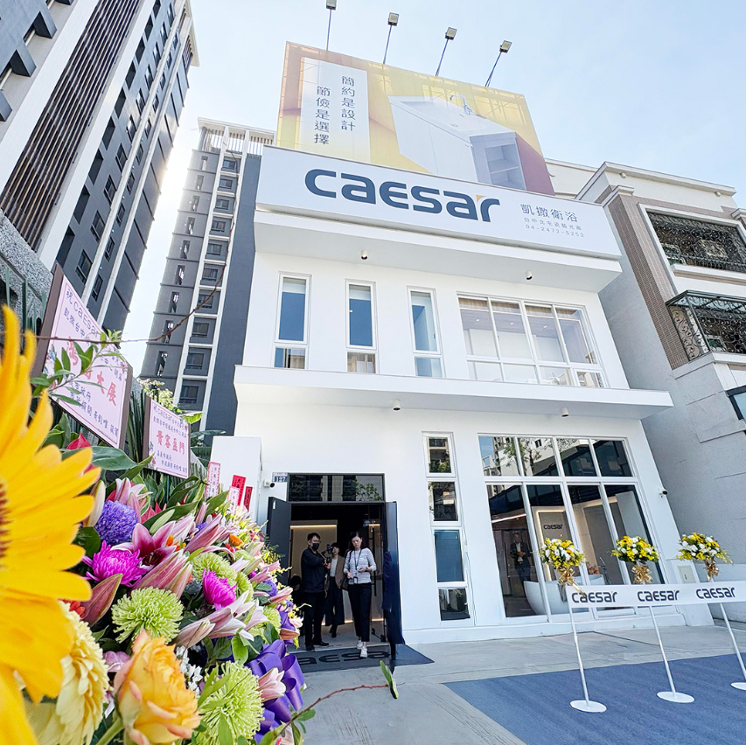
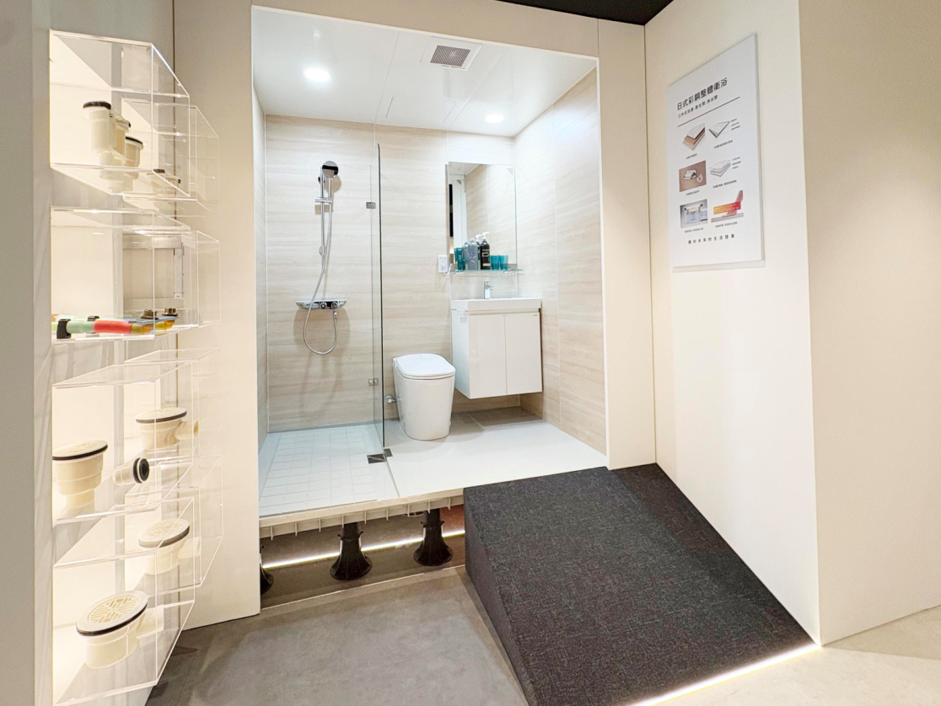
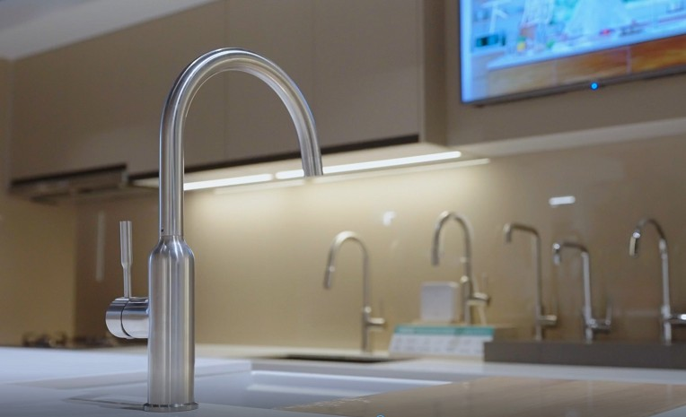
Taichung Flagship Showroom Grand Opening
23

Slide 24
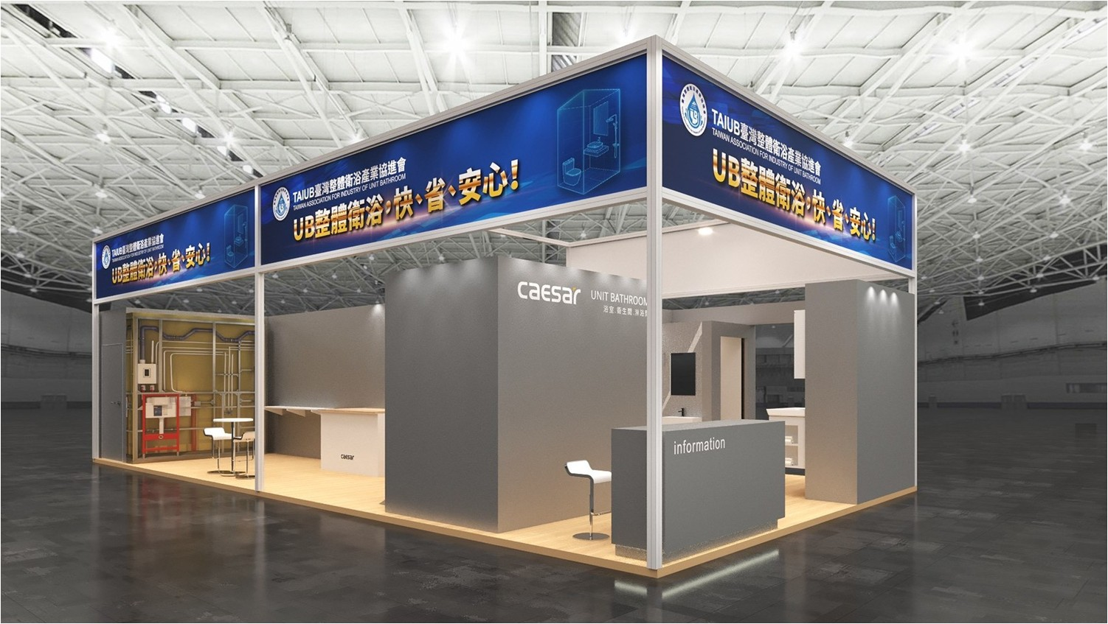
Caesar UB/UT Solution
24
Notes:
自2021年起，玉山每年舉辦ESG永續倡議行動，攜手企業夥伴們共同承諾並採取具體行動減緩對環境與自然的衝擊，今年邁入第四年，參與夥伴除了來自各產業龍頭、隱形冠軍、海外台商等逾百家企業外，更號召26家醫療院所以及來自丹麥、希臘、美國、新加坡、日本等國際大型企業共襄盛舉，影響力已顯成效。在舉辦倡議行動同時，玉山已打造永續轉型平台，整合產學研界量能，提升永續生態圈韌性，協助企業面對淨零轉型的挑戰。
玉山金控董事長黃男州表示，「一個好的ESG策略，就是一個好的企業發展策略」，全球對氣候、環境、社會等議題的重視及渴望轉型，讓ESG成為企業長久經營不可或缺的一環。

Slide 25
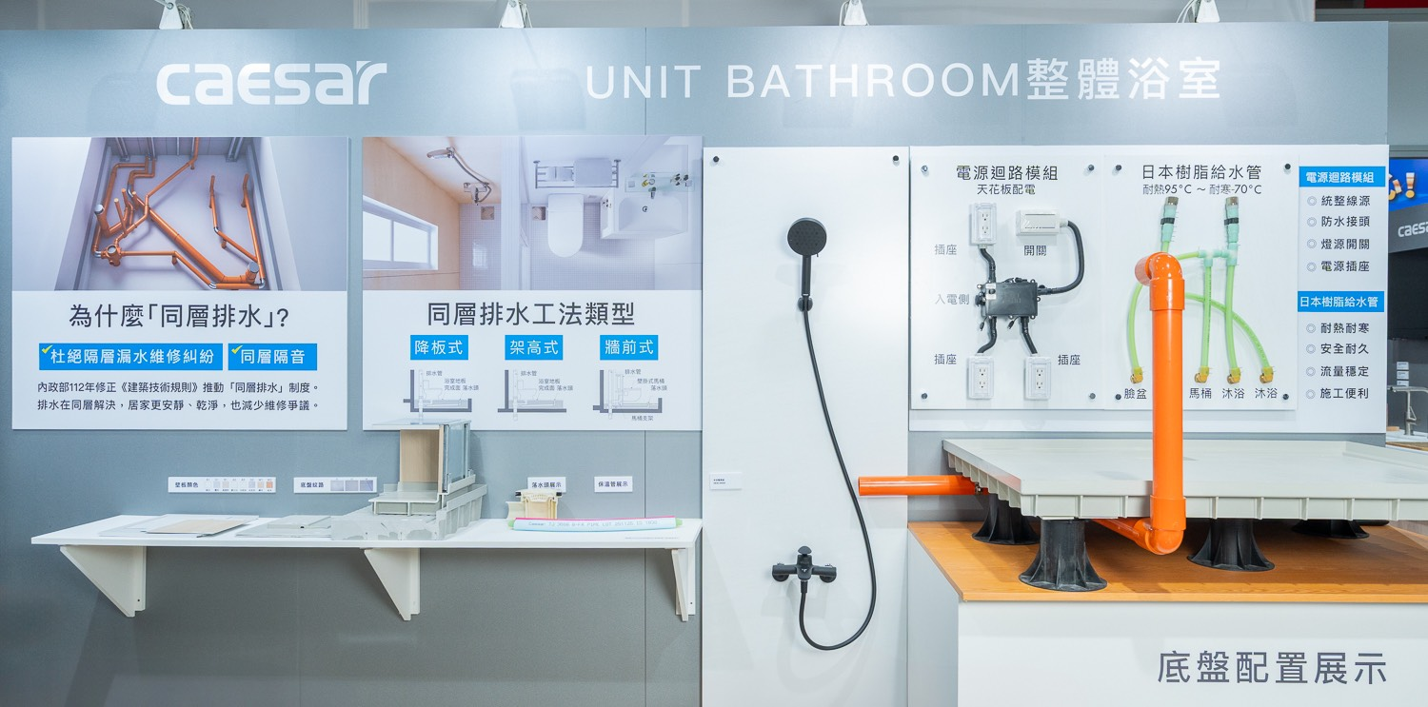
Caesar UB/UT Solution
25
Notes:
自2021年起，玉山每年舉辦ESG永續倡議行動，攜手企業夥伴們共同承諾並採取具體行動減緩對環境與自然的衝擊，今年邁入第四年，參與夥伴除了來自各產業龍頭、隱形冠軍、海外台商等逾百家企業外，更號召26家醫療院所以及來自丹麥、希臘、美國、新加坡、日本等國際大型企業共襄盛舉，影響力已顯成效。在舉辦倡議行動同時，玉山已打造永續轉型平台，整合產學研界量能，提升永續生態圈韌性，協助企業面對淨零轉型的挑戰。
玉山金控董事長黃男州表示，「一個好的ESG策略，就是一個好的企業發展策略」，全球對氣候、環境、社會等議題的重視及渴望轉型，讓ESG成為企業長久經營不可或缺的一環。

Slide 26
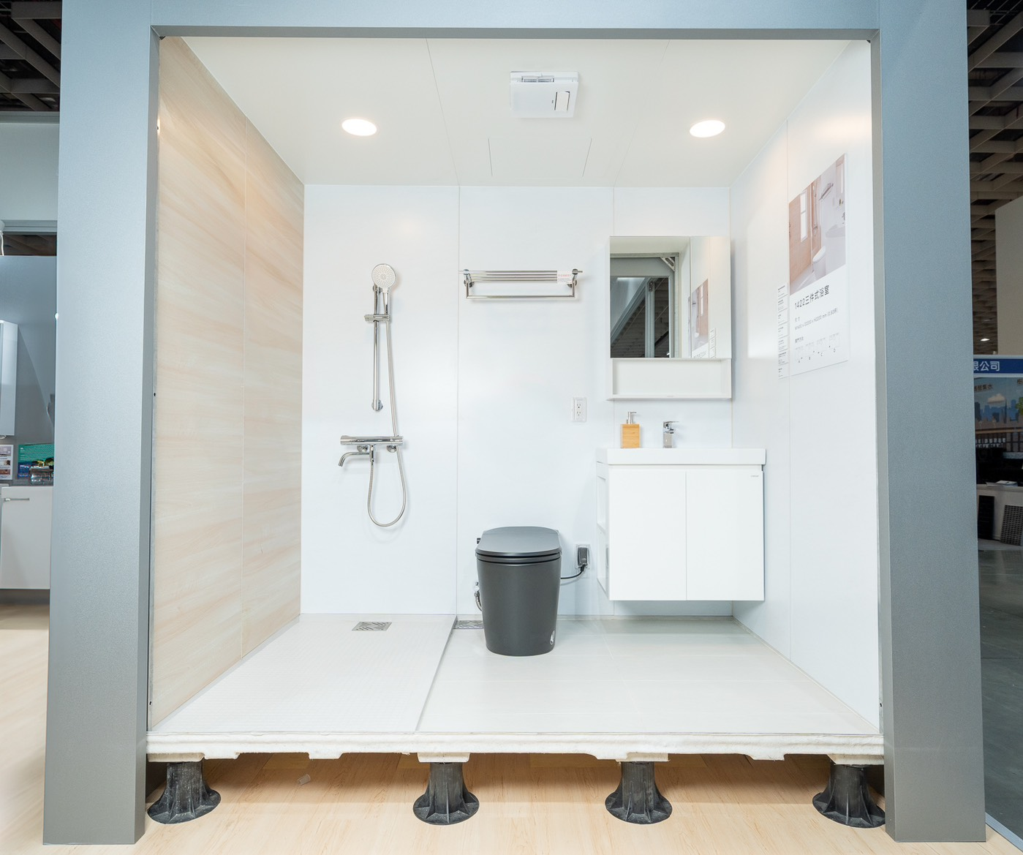
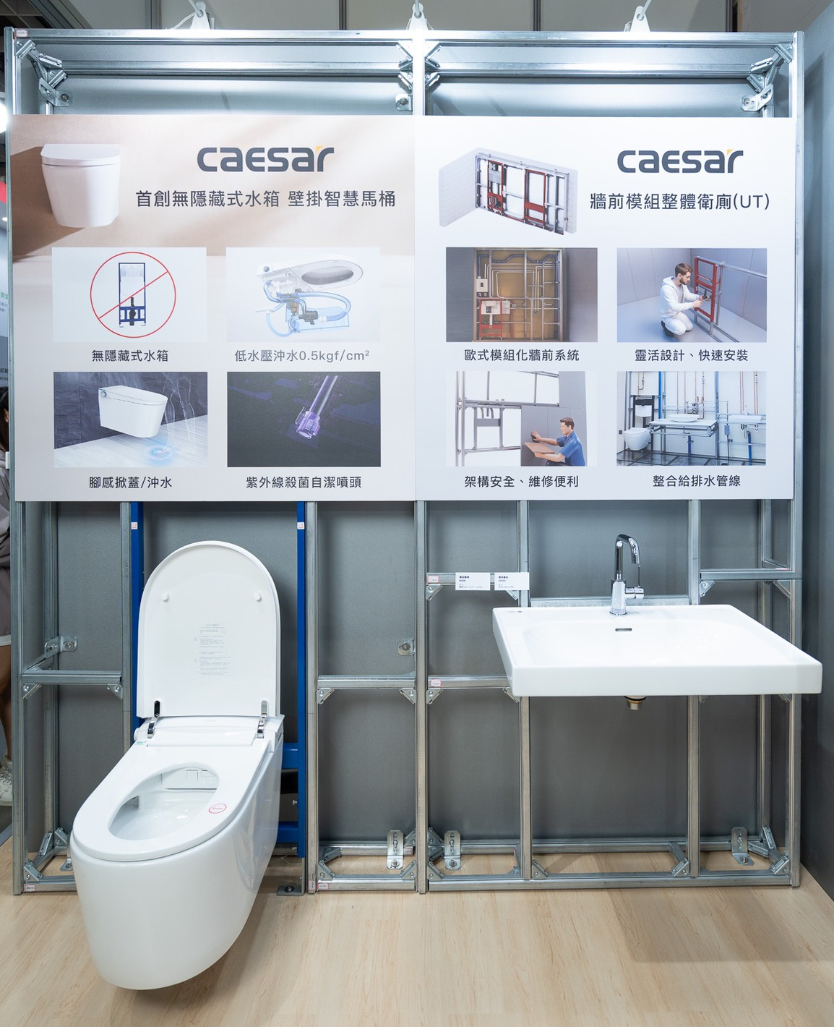
Caesar UB/UT Solution
26
Notes:
自2021年起，玉山每年舉辦ESG永續倡議行動，攜手企業夥伴們共同承諾並採取具體行動減緩對環境與自然的衝擊，今年邁入第四年，參與夥伴除了來自各產業龍頭、隱形冠軍、海外台商等逾百家企業外，更號召26家醫療院所以及來自丹麥、希臘、美國、新加坡、日本等國際大型企業共襄盛舉，影響力已顯成效。在舉辦倡議行動同時，玉山已打造永續轉型平台，整合產學研界量能，提升永續生態圈韌性，協助企業面對淨零轉型的挑戰。
玉山金控董事長黃男州表示，「一個好的ESG策略，就是一個好的企業發展策略」，全球對氣候、環境、社會等議題的重視及渴望轉型，讓ESG成為企業長久經營不可或缺的一環。

Slide 27


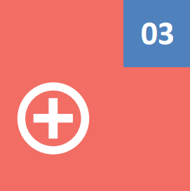
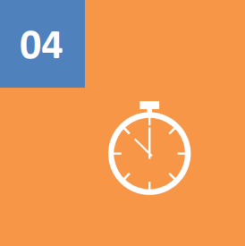
Future Outlook
The impact of Trump’s tariffs
Recession fears
Global stock markets turbulent
Exchange rate
Smart and sustainable bathroom
Bathroom storage
Smart bathroom
Global aging trend
Market/Channel strategy
Product value- up
Diversified market
Diversified channel
Outlook
Strengthen automation and AI applications to improve overall gross profit structure
Flexibility to respond to changes in the geopolitical and tariff environment
27
Notes:
Other countries, including Japan, Korea, Malaysia, China, Philippines, Australia, Myanmar, Cambodia, USA, etc

Slide 28


28
Notes:
Other countries, including Japan, Korea, Malaysia, China, Philippines, Australia, Myanmar, Cambodia, USA, etc

